Slide 1
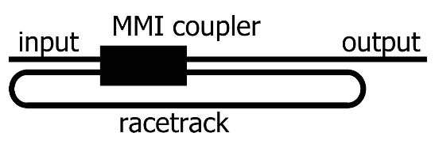
Strain Sensor
Artigo - Characterization of a photonic strain sensor in silicon-on-insulator technology.
Ring resonator acoplado por MMI, feito em SOI;
Comprimento (racetrack) igual a 1040 µm e raio igual a 25 µm;
Espessura igual a 300 nm;
Largura considerada como 400 nm e 1000 nm.

Slide 2
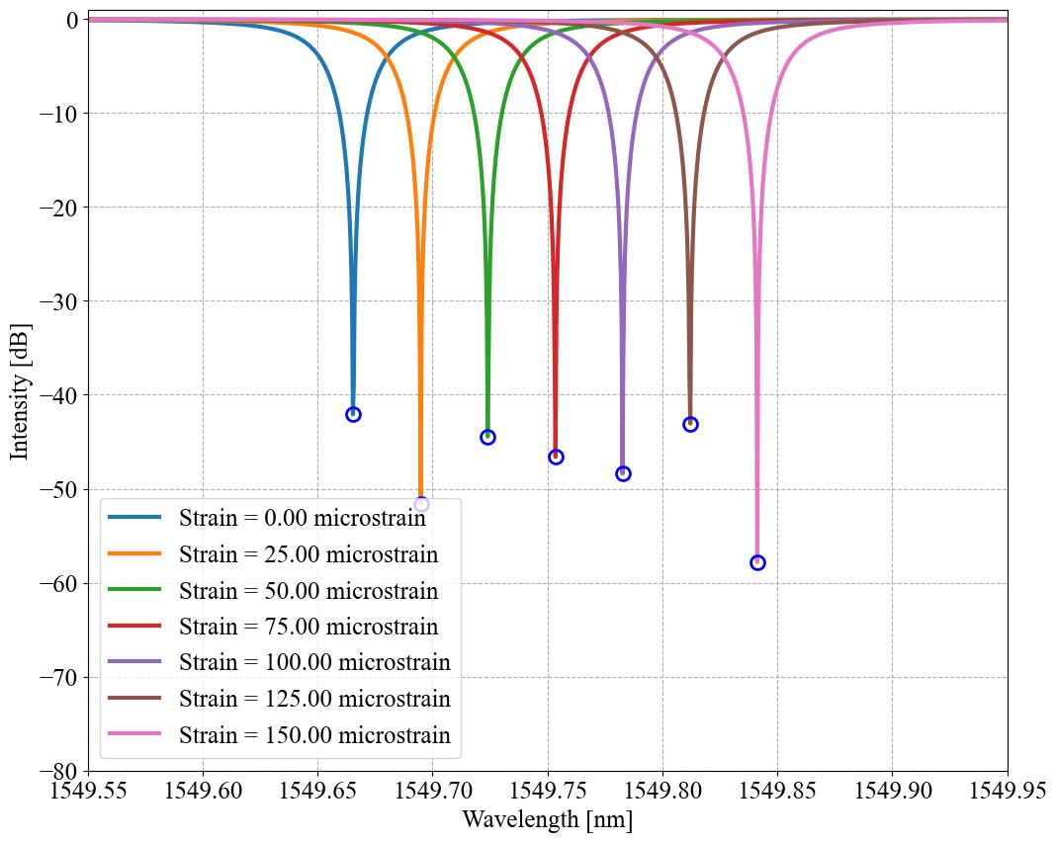
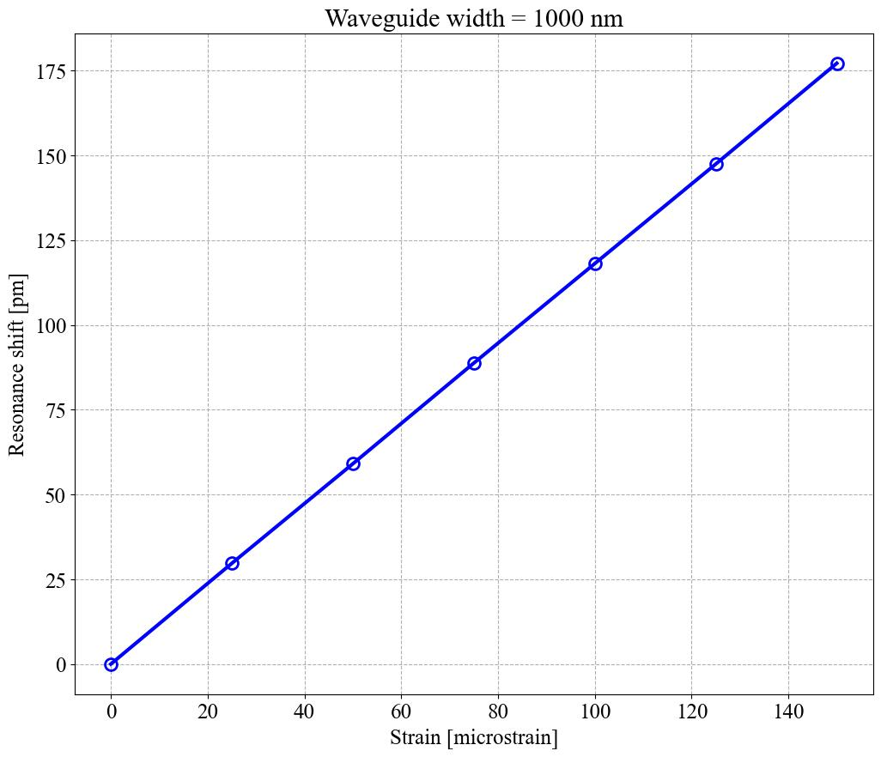
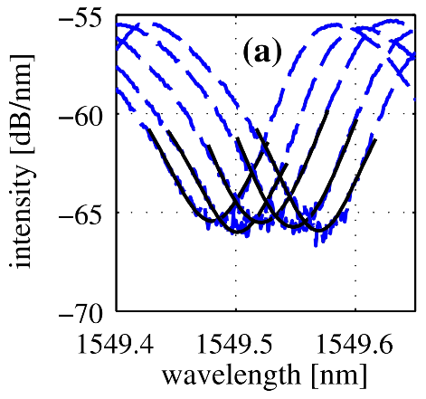
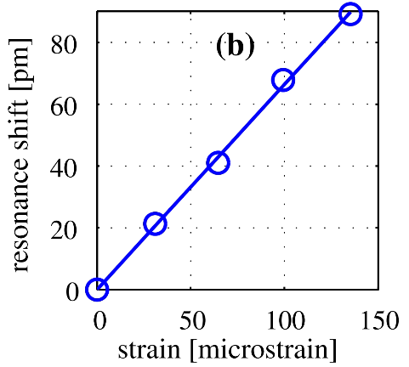
Strain Sensor
Resonance shift X Strain.

Slide 3
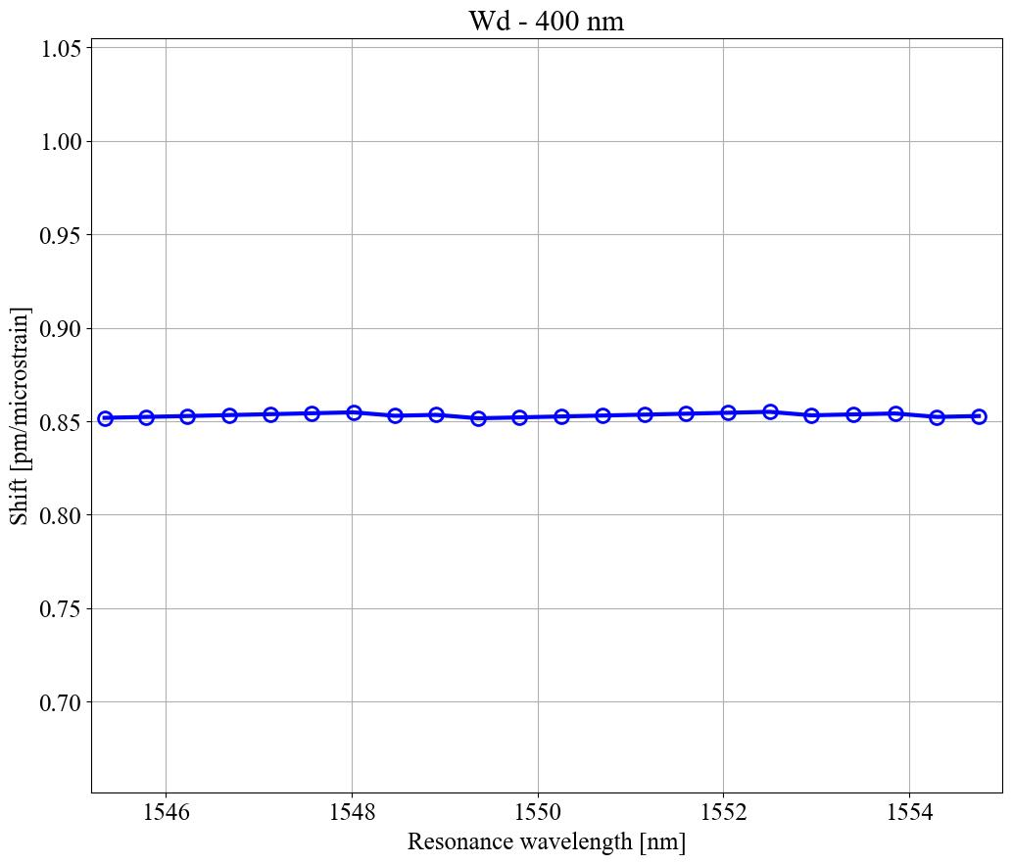
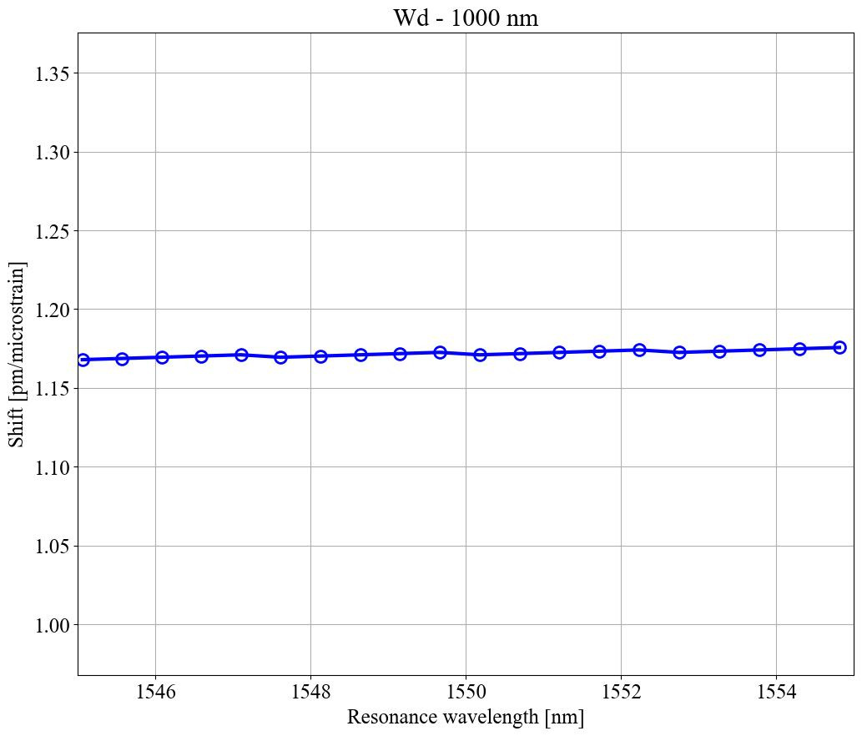
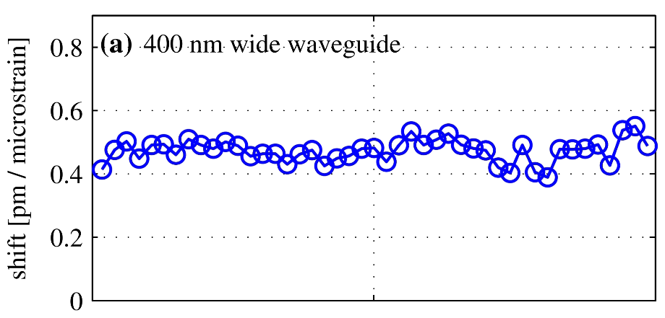
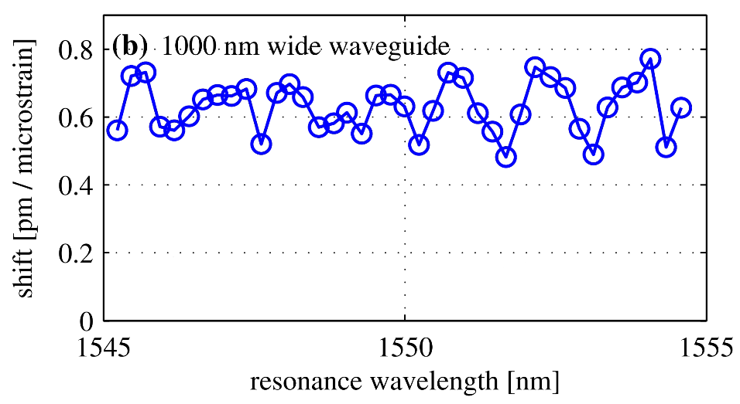
Strain Sensor
Shift X Resonance wavelength.

